Slide 1
Uptake case study: prediction task
Kaiqi Zheng

Slide 2
Basic insight
The training dataset has about 180000 rows, 481 columns.
It is a weak supervised problem.
data types include category, int, float.

Slide 3
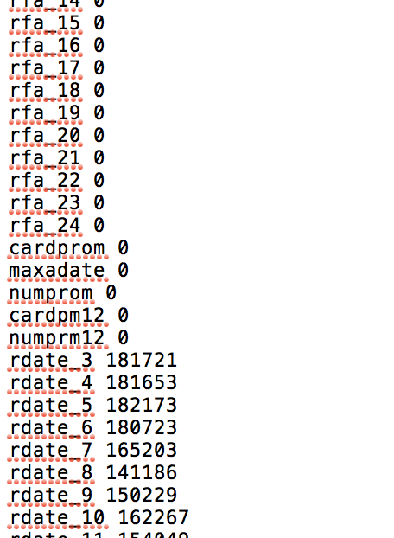
List the null statistics
List the null value in each attribute column.
I decide to drop those attributes which has more than half values are null.
Also, the empty value in category attribute should also count as null.
After dropping, the rest of attribute number is 381.

Slide 4
Handle missing data
For those attribute which missing data is more than a half,
Drop the attribute
For the rest attribute,
If it is categorial, use mode to fill nan.
If it is numerical, use median to fill nan.

Slide 5
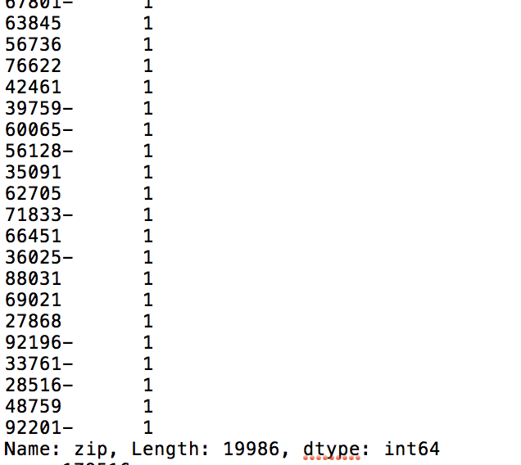
And also some values include extra characters
The dash line in the end need to be deleted.

Slide 6
Change into supervised problem
Convert the amount attribute.
If it is nan, then fill with 0.
If larger than 0, replace with 1.

Slide 7
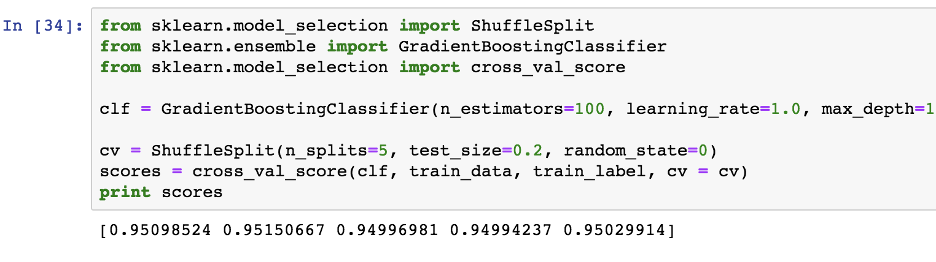
The cross validation score
I trained gradient boosting classifier on training set.

Slide 8
Handling testing set
The testing set has no amount and responded attribute.
We need to copy all the remained attribute from training set after filtering, except for amount and responded attribute.
Also, use the mode and median in training set to fill with the nan in testing set.

Slide 9
prediction
Apply the gradient boosting classifier on testing set

Slide 10
Thank you!

